Slide 1
Cascading Style Sheet(CSS) Part_2

Slide 2
CSS Margins
The CSS margin properties are used to create space around elements, outside of any defined borders.
With CSS, you have full control over the margins. There are properties for setting the margin for each side of an element (top, right, bottom, and left).
CSS has properties for specifying the margin for each side of an element:
margin-top
margin-right
margin-bottom
margin-left
All the margin properties can have the following values:
auto - the browser calculates the margin
length - specifies a margin in px, pt, cm, etc.
% - specifies a margin in % of the width of the containing element
inherit - specifies that the margin should be inherited from the parent element

Slide 3
Example
Set different margins for all four sides of a <p> element:
p { margin-top: 100px; margin-bottom: 100px; margin-right: 150px; margin-left: 80px; }

Slide 4
Margin - Shorthand Property
To shorten the code, it is possible to specify all the margin properties in one property.
The margin property is a shorthand property for the following individual margin properties:
margin-top
margin-right
margin-bottom
margin-left
So, here is how it works:
If the margin property has four values:
margin: 25px 50px 75px 100px;
top margin is 25px
right margin is 50px
bottom margin is 75px
left margin is 100px
Example: Use the margin shorthand property with four values:
p { margin: 25px 50px 75px 100px; }

Slide 5
Example
If the margin property has three values:
margin: 25px 50px 75px;
top margin is 25px
right and left margins are 50px
bottom margin is 75px
Example: Use the margin shorthand property with three values:
p { margin: 25px 50px 75px; }
If the margin property has two values:
margin: 25px 50px;
top and bottom margins are 25px
right and left margins are 50px
Example: Use the margin shorthand property with two values:
p { margin: 25px 50px; }
If the margin property has one value:
margin: 25px;
all four margins are 25px
Example: Use the margin shorthand property with one value:
p { margin: 25px; }

Slide 6
The auto Value
You can set the margin property to auto to horizontally center the element within its container.
The element will then take up the specified width, and the remaining space will be split equally between the left and right margins.
Example: Use margin auto:
p { width: 300px; margin: auto; border: 1px solid red; }

Slide 7
CSS Padding
The CSS padding properties are used to generate space around an element's content, inside of any defined borders.
With CSS, you have full control over the padding. There are properties for setting the padding for each side of an element (top, right, bottom, and left).
Padding - Individual Sides
CSS has properties for specifying the padding for each side of an element:
padding-top
padding-right
padding-bottom
padding-left
All the padding properties can have the following values:
length - specifies a padding in px, pt, cm, etc.
% - specifies a padding in % of the width of the containing element
inherit - specifies that the padding should be inherited from the parent element
Note: Negative values are not allowed.

Slide 8
Example
Set different padding for all four sides of a <p> element:
p { padding-top: 50px; padding-right: 30px; padding-bottom: 50px; padding-left: 80px; }

Slide 9
Padding - Shorthand Property
To shorten the code, it is possible to specify all the padding properties in one property.
The padding property is a shorthand property for the following individual padding properties:
padding-top
padding-right
padding-bottom
padding-left
So, here is how it works:
If the padding property has four values:
padding: 25px 50px 75px 100px;
top padding is 25px
right padding is 50px
bottom padding is 75px
left padding is 100px
Example: Use the padding shorthand property with four values:
p { padding: 25px 50px 75px 100px; }
If the padding property has three values:
padding: 25px 50px 75px;
top padding is 25px
right and left paddings are 50px
bottom padding is 75px
Example: Use the padding shorthand property with three values:
p { padding: 25px 50px 75px; }

Slide 10
Padding - Shorthand Property(Conts)
If the padding property has two values:
padding: 25px 50px;
top and bottom paddings are 25px
right and left paddings are 50px
Example: Use the padding shorthand property with two values:
p { padding: 25px 50px; }
If the padding property has one value:
padding: 25px;
all four paddings are 25px
Example: Use the padding shorthand property with one value:
p { padding: 25px; }

Slide 11
CSS Setting height and width
The height and width properties are used to set the height and width of an element.
The height and width properties do not include padding, borders, or margins. It sets the height/width of the area inside the padding, border, and margin of the element.
CSS height and width Values
The height and width properties may have the following values:
auto - This is default. The browser calculates the height and width
length - Defines the height/width in px, cm etc.
% - Defines the height/width in percent of the containing block
initial - Sets the height/width to its default value
inherit - The height/width will be inherited from its parent value

Slide 12
CSS Setting height and width(Conts)
Example: Set the height and width of a <p> element:
p { height: 200px; width: 50%; background-color: powderblue; }
Example: Set the height and width of another <p> element:
p { height: 100px; width: 500px; background-color: powderblue; }

Slide 13
Setting max-width
The max-width property is used to set the maximum width of an element.
The max-width can be specified in length values, like px, cm, etc., or in percent (%) of the containing block, or set to none (this is default. Means that there is no maximum width).
The problem with the <p> above occurs when the browser window is smaller than the width of the element (500px). The browser then adds a horizontal scrollbar to the page.
Using max-width instead, in this situation, will improve the browser's handling of small windows.
This element has a height of 100 pixels and a max-width of 500 pixels.
Note: The value of the max-width property overrides width.

Slide 14
Example
This <P> element has a height of 100 pixels and a max-width of 500 pixels:
p { max-width: 500px; height: 100px; background-color: powderblue; }

Slide 15
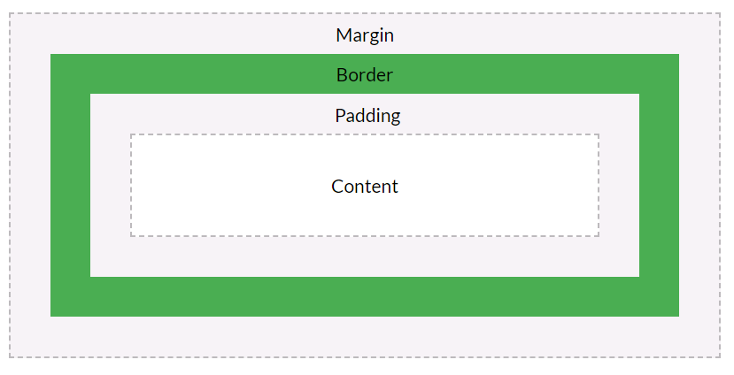
The CSS Box Model
All HTML elements can be considered as boxes. In CSS, the term "box model" is used when talking about design and layout.
The CSS box model is essentially a box that wraps around every HTML element. It consists of: margins, borders, padding, and the actual content. The image below illustrates the box model:

Slide 16
The CSS Box Model(Conts)
Explanation of the different parts:
Content - The content of the box, where text and images appear
Padding - Clears an area around the content. The padding is transparent
Border - A border that goes around the padding and content
Margin - Clears an area outside the border. The margin is transparent
The box model allows us to add a border around elements, and to define space between elements.
Example: Demonstration of the box model:
p { width: 300px; border: 15px solid green; padding: 50px; margin: 20px; }

Slide 17
CSS Outline
An outline is a line that is drawn around elements, OUTSIDE the borders, to make the element "stand out".
CSS has the following outline properties:
outline-style
outline-color
outline-width
outline-offset
outline
Note: Outline differs from borders! Unlike border, the outline is drawn outside the element's border, and may overlap other content. Also, the outline is NOT a part of the element's dimensions; the element's total width and height is not affected by the width of the outline.

Slide 18

CSS Outline Style
The outline-style property specifies the style of the outline, and can have one of the following values:
dotted - Defines a dotted outline
dashed - Defines a dashed outline
solid - Defines a solid outline
double - Defines a double outline
groove - Defines a 3D grooved outline
ridge - Defines a 3D ridged outline
inset - Defines a 3D inset outline
outset - Defines a 3D outset outline
none - Defines no outline
hidden - Defines a hidden outline

Slide 19
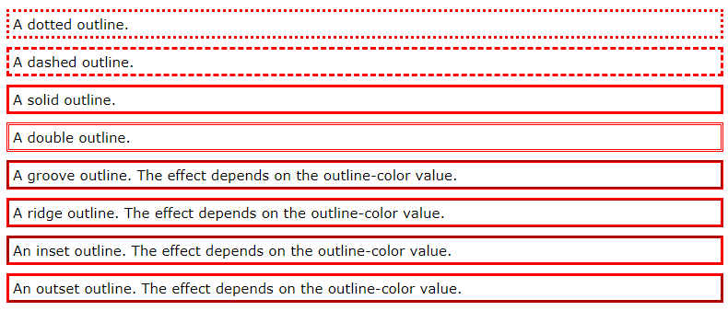
CSS Outline Style(Conts)
Example: Demonstration of the different outline styles:
p.dotted {outline-style: dotted;} p.dashed {outline-style: dashed;} p.solid {outline-style: solid;} p.double {outline-style: double;} p.groove {outline-style: groove;} p.ridge {outline-style: ridge;} p.inset {outline-style: inset;} p.outset {outline-style: outset;}

Slide 20
CSS Outline Width
The outline-width property specifies the width of the outline, and can have one of the following values:
thin (typically 1px)
medium (typically 3px)
thick (typically 5px)
A specific size (in px, pt, cm, em, etc)
The following example shows some outlines with different widths:
p.ex1 { border: 1px solid black; outline-style: solid; outline-color: red; outline-width: thin; } p.ex2 { border: 1px solid black; outline-style: solid; outline-color: red; outline-width: medium; } p.ex3 { border: 1px solid black; outline-style: solid; outline-color: red; outline-width: thick; } p.ex4 { border: 1px solid black; outline-style: solid; outline-color: red; outline-width: 4px;}

Slide 21
CSS Outline Color
The outline-color property is used to set the color of the outline.
The color can be set by:
name - specify a color name, like "red"
HEX - specify a hex value, like "#ff0000"
RGB - specify a RGB value, like "rgb(255,0,0)"
HSL - specify a HSL value, like "hsl(0, 100%, 50%)"
Example
p.ex1 { border: 2px solid black; outline-style: solid; outline-color: red; } p.ex2 { border: 2px solid black; outline-style: dotted; outline-color: blue; } p.ex3 { border: 2px solid black; outline-style: outset; outline-color: grey; }

Slide 22
CSS Outline - Shorthand property
The outline property is a shorthand property for setting the following individual outline properties:
outline-width
outline-style (required)
outline-color
Example
p.ex1 {outline: dashed;} p.ex2 {outline: dotted red;} p.ex3 {outline: 5px solid yellow;} p.ex4 {outline: thick ridge pink;}

Slide 23
CSS Outline Offset
The outline-offset property adds space between an outline and the edge/border of an element. The space between an element and its outline is transparent.
The following example specifies an outline 15px outside the border edge:
Example
p { margin: 30px; border: 1px solid black; outline: 1px solid red; outline-offset: 15px; }

Slide 24
CSS Text
Text Color
The color property is used to set the color of the text. The color is specified by:
a color name - like "red"
a HEX value - like "#ff0000"
an RGB value - like "rgb(255,0,0)"
Text Color and Background Color
In this example, we define both the background-color property and the color property:
Example
body { background-color: lightgrey; color: blue; } h1 { background-color: black; color: white; }

Slide 25
CSS Text(Cont’s)
Text Alignment
The text-align property is used to set the horizontal alignment of a text.
A text can be left or right aligned, centered, or justified.
The following example shows center aligned, and left and right aligned text (left alignment is default if text direction is left-to-right, and right alignment is default if text direction is right-to-left):
Example
h1 { text-align: center; } h2 { text-align: left; } h3 { text-align: right; }

Slide 26
CSS Text(Cont’s)
Text Direction
The direction and unicode-bidi properties can be used to change the text direction of an element:
Example
p { direction: rtl; }

Slide 27
CSS Text(Cont’s)
Text Decoration
The text-decoration property is used to set or remove decorations from text.
The value text-decoration: none; is often used to remove underlines from links:
Example
a { text-decoration: none; }
The other text-decoration values are used to decorate text:
Example
h2 { text-decoration: line-through; } h3 { text-decoration: underline; }

Slide 28
CSS Text(Cont’s)
Text Transformation
The text-transform property is used to specify uppercase and lowercase letters in a text.
It can be used to turn everything into uppercase or lowercase letters, or capitalize the first letter of each word:
Example
p.uppercase { text-transform: uppercase; } p.lowercase { text-transform: lowercase; } p.capitalize { text-transform: capitalize; }

Slide 29
CSS Text(Cont’s)
Text Spacing
Text Indentation
The text-indent property is used to specify the indentation of the first line of a text:
Example
p { text-indent: 50px; }
Letter Spacing
The letter-spacing property is used to specify the space between the characters in a text.
The following example demonstrates how to increase or decrease the space between characters:
Example
h1 { letter-spacing: 3px; } h2 { letter-spacing: -3px; }

Slide 30
CSS Text(Cont’s)
Line Height
The line-height property is used to specify the space between lines:
Example
p.small { line-height: 0.8; } p.big { line-height: 1.8; }
Word Spacing
The word-spacing property is used to specify the space between the words in a text.
The following example demonstrates how to increase or decrease the space between words:
Example
h1 { word-spacing: 10px; } h2 { word-spacing: -5px; }

Slide 31
CSS Text(Cont’s)
White Space
The white-space property specifies how white-space inside an element is handled.
This example demonstrates how to disable text wrapping inside an element:
Example
p { white-space: nowrap; }

Slide 32
CSS Text(Cont’s)
Text Shadow
The text-shadow property adds shadow to text.
In its simplest use, you only specify the horizontal shadow (2px) and the vertical shadow (2px):
Example
h1 { text-shadow: 2px 2px; }
Next, add a color (red) to the shadow:
Example
h1 { text-shadow: 2px 2px red; }
Then, add a blur effect (5px) to the shadow:
Example
h1 { text-shadow: 2px 2px 5px red; }

Slide 33
CSS Font
Font Style
The font-style property is mostly used to specify italic text.
This property has three values:
normal - The text is shown normally
italic - The text is shown in italics
oblique - The text is "leaning" (oblique is very similar to italic, but less supported)
Example
p.normal { font-style: normal; } p.italic { font-style: italic; } p.oblique { font-style: oblique; }

Slide 34
CSS Font(Cont’s)
Font Weight
The font-weight property specifies the weight of a font:
Example
p.normal { font-weight: normal; } p.thick { font-weight: bold; }
Font Variant
The font-variant property specifies whether or not a text should be displayed in a small-caps font.
In a small-caps font, all lowercase letters are converted to uppercase letters. However, the converted uppercase letters appears in a smaller font size than the original uppercase letters in the text.
Example
p.normal { font-variant: normal; } p.small { font-variant: small-caps; }

Slide 35
CSS Font(Cont’s)
Font Size
The font-size property sets the size of the text.
If you do not specify a font size, the default size for normal text, like paragraphs, is 16px (16px=1em).
Set Font Size With Pixels
Setting the text size with pixels gives you full control over the text size:
Example
h1 { font-size: 40px; } h2 { font-size: 30px; } p { font-size: 14px; }

Slide 36
CSS Font(Cont’s)
Set Font Size With Em(emphemeral unit)
To allow users to resize the text (in the browser menu), many developers use em instead of pixels.
1em is equal to the current font size. The default text size in browsers is 16px. So, the default size of 1em is 16px.
The size can be calculated from pixels to em using this formula: pixels/16=em
Example
h1 { font-size: 2.5em; /* 40px/16=2.5em */ } h2 { font-size: 1.875em; /* 30px/16=1.875em */ } p { font-size: 0.875em; /* 14px/16=0.875em */ }

Slide 37
CSS Lists
HTML Lists and CSS List Properties
In HTML, there are two main types of lists:
unordered lists (<ul>) - the list items are marked with bullets
ordered lists (<ol>) - the list items are marked with numbers or letters
The CSS list properties allow you to:
Set different list item markers for ordered lists
Set different list item markers for unordered lists
Set an image as the list item marker
Add background colors to lists and list items

Slide 38
CSS Lists(Conts)
Different List Item Markers
The list-style-type property specifies the type of list item marker.
The following example shows some of the available list item markers:
Example
ul.a { list-style-type: circle; } ul.b { list-style-type: square; } ol.c { list-style-type: upper-roman; } ol.d { list-style-type: lower-alpha; }

Slide 39
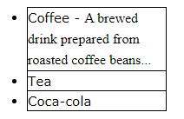
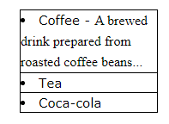
CSS Lists(Conts)
An Image as The List Item Marker
The list-style-image property specifies an image as the list item marker:
Example
ul { list-style-image: url('sqpurple.gif'); }
Position The List Item Markers
The list-style-position property specifies the position of the list-item markers (bullet points).
"list-style-position: outside;" means that the bullet points will be outside the list item. The start of each line of a list item will be aligned vertically. This is default:
"list-style-position: inside;" means that the bullet points will be inside the list item. As it is part of the list item, it will be part of the text and push the text at the start:

Slide 40
CSS Lists(Conts)
Remove Default Settings
The list-style-type:none property can also be used to remove the markers/bullets.
Note that the list also has default margin and padding. To remove this, add margin:0 and padding:0 to <ul> or <ol>:
Example
ul { list-style-type: none; margin: 0; padding: 0; }

Slide 41
CSS Tables
Table Borders
To specify table borders in CSS, use the border property.
The example below specifies a black border for <table>, <th>, and <td> elements:
Example
table, th, td { border: 1px solid black; }

Slide 42
CSS Tables(Cont’s)
Table Width and Height
The width and height of a table are defined by the width and height properties.
The example below sets the width of the table to 100%, and the height of the <th> elements to 70px:
Example
table { width: 100%; } th { height: 70px; }

Slide 43
CSS Tables(Cont’s)
Horizontal Alignment
The text-align property sets the horizontal alignment (like left, right, or center) of the content in <th> or <td>.
By default, the content of <th> elements are center-aligned and the content of <td> elements are left-aligned.
To center-align the content of <td> elements as well, use text-align: center:
Example
td { text-align: center; }

Slide 44
CSS Tables(Cont’s)
Table Color
The example below specifies the background color and text color of <th> elements:
Example
th { background-color: #4CAF50; color: white; }

Slide 45
CSS Pseudo-classes
What are Pseudo-classes?
A pseudo-class is used to define a special state of an element.
For example, it can be used to:
Style an element when a user mouses over it
Style visited and unvisited links differently
Style an element when it gets focus
Syntax
The syntax of pseudo-classes:
selector:pseudo-class { property: value; }

Slide 46
CSS Links
Links can be styled with any CSS property (e.g. color, font-family, background, etc.).
Example
a { color: hotpink; }
Links can be styled differently depending on what state they are in.
The four links states are:
a:link - a normal, unvisited link
a:visited - a link the user has visited
a:hover - a link when the user mouses over it
a:active - a link the moment it is clicked

Slide 47
CSS Links(Cont’s)
Example
/* unvisited link */ a:link { color: red; } /* visited link */ a:visited { color: green; } /* mouse over link */ a:hover { color: hotpink; } /* selected link */ a:active { color: blue; }
When setting the style for several link states, there are some order rules:
a:hover MUST come after a:link and a:visited
a:active MUST come after a:hover

Slide 48
CSS Links(Cont’s)
Text Decoration
The text-decoration property is mostly used to remove underlines from links:
Example
a:link { text-decoration: none; } a:visited { text-decoration: none; } a:hover { text-decoration: underline; } a:active { text-decoration: underline; }

Slide 49
CSS Links(Cont’s)
Background Color
The background-color property can be used to specify a background color for links:
Example
a:link { background-color: yellow; } a:visited { background-color: cyan; } a:hover { background-color: lightgreen; } a:active { background-color: hotpink; }

Slide 50
Pseudo-classes and CSS Classes
Pseudo-classes can be combined with CSS classes:
When you hover over the link in the example, it will change color:
Example
a.highlight:hover { color: #ff0000; }

Slide 51
CSS Pseudo-elements
What are Pseudo-Elements?
A CSS pseudo-element is used to style specified parts of an element.
For example, it can be used to:
Style the first letter, or line, of an element
Insert content before, or after, the content of an element
The syntax of pseudo-elements:
selector::pseudo-element { property: value; }

Slide 52
The ::first-line Pseudo-element
The ::first-line pseudo-element is used to add a special style to the first line of a text.
The following example formats the first line of the text in all <p> elements:
Example
p::first-line { color: #ff0000; font-variant: small-caps; }

Slide 53
The ::first-letter Pseudo-element
The ::first-letter pseudo-element is used to add a special style to the first letter of a text.
The following example formats the first letter of the text in all <p> elements:
Example
p::first-letter { color: #ff0000; font-size: xx-large; }

Slide 54
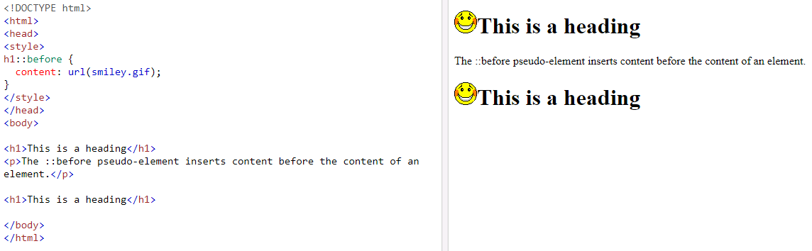
The ::before Pseudo-element
The ::before pseudo-element can be used to insert some content before the content of an element.
The following example inserts an image before the content of each <h1> element:
Example
h1::before { content: url(smiley.gif); }

Slide 55
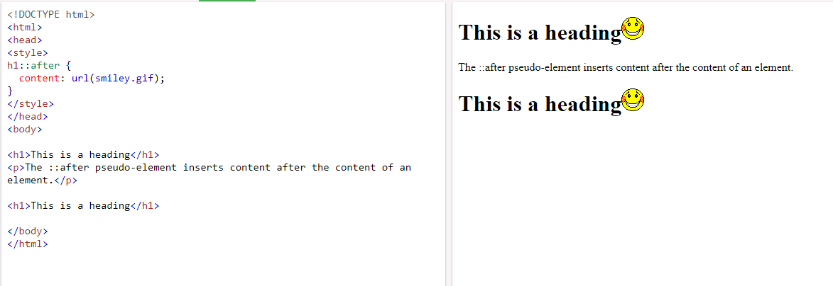
The ::after Pseudo-element
The ::after pseudo-element can be used to insert some content after the content of an element.
The following example inserts an image after the content of each <h1> element:
Example
h1::after { content: url(smiley.gif); }

Slide 56
CSS Opacity / Transparency
The opacity property specifies the opacity/transparency of an element.
Transparent Image
The opacity property can take a value from 0.0 - 1.0. The lower value, the more transparent:
Example
img { opacity: 0.5; }
Transparent Hover Effect
The opacity property is often used together with the :hover selector to change the opacity on mouse-over:
Example
img { opacity: 0.5; } img:hover { opacity: 1.0; }

